Slide 1

Let’s Build A ChatBot Taming the Python
ISPVMF Global Retreat 2017
Notes:
E1 - Good Morning, Welcome to the first day of the ISMPVMF retreat and an interesting segment – The programming challenge. I am <> and I am <>.
E2 – Are you sure you are in the right place – this is not a TD retreat, what is programming doing here? It’s ISPVMF retreat
E1 – Yes yes, I know it’s quite unusual, but this is very much for this fantastic group of ISPVMF.
You may think today’s session is a lesson on programming. But no, this is about playing a team game and challenging your colleagues to win some exciting prizes – and along the way picking up some useful programming skills. There is no programming skill or prior experience needed, and each one of us can participate. The basics of programming will be weaved into challenges through some fun tools, to expose the logic and analytical thinking process behind it.

Slide 2
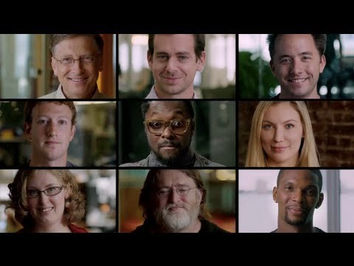
Everybody can code!
https://www.youtube.com/watch?v=nKIu9yen5nc
Notes:
(Pre-video) Now here’s a short video featuring people from diverse backgrounds like sports, musicians, CEOs, etc. sharing about programming.
(Post-video) This video demonstrates the simple point that everybody can and should learn programming. Today’s session is about giving you a start on this journey.

Slide 3


Golden Quotes
“Everybody in this country should learn how to program a computer…because it teaches you how to think.”
– Steve Jobs
“The core skills that programing brings out in every one of us is logical/analytical thinking and the ability to solve problems in a creative manner.”
- Hoe Yin
Notes:
The famous Steve Jobs once said:…
The equally famous personality in GIC circles has said….
So let’s look forward to a fun-filled session to gain some handy coding skills which has a potential to blossom into a core skill for you to be Future Ready in the tech-driven business model.

Slide 4

Aim
1. Introduction to Basic Python & Web Scraping
2. Get to Know One Another Better ..
3. And Most Importantly,

Slide 5


What’s In Store
Appetiser
11:15-11:30 - Introduction
11:30-12:30 – Baby Python
12:30-1:00 - Lunch Break
Main Course
1:00-1:30 – Say Hello to ReBot
1:30-2:30 – Baby Python +
2:30-4:00 – Taming the Python
4:00-4:30 – Short Break
Dessert
4:30-5:15 – Idea Generation and Pitch preparation
5:15-5:30 - Move to 38 Auditorium
5:30-6:15 – Pitch, Awards and Closing
Notes:
Here’s the agenda for today

Slide 6
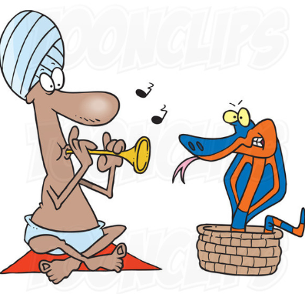
PLAYING WITH Baby PYTHON
Notes:
Scratch
With Scratch, you can program your own interactive stories, games, and animations — and share your creations with others around the world. Scratch was created to help people learn to think creatively, reason systematically and work collaboratively.
Python, HTML/JSON
Hands-on practice to learn how website is built using HTML. And using Python, you can learn how to extract information from website and transform the data from unstructured data (HTML) into structured data (database or spreadsheet).
Chatbot
Apply web scraping technique involving Python, HTML/JSON to build a conversational UI.
Example of conversational UI e.g. live chat customer service

Slide 7
Lunch break
Notes:
Scratch
With Scratch, you can program your own interactive stories, games, and animations — and share your creations with others around the world. Scratch was created to help people learn to think creatively, reason systematically and work collaboratively.
Python, HTML/JSON
Hands-on practice to learn how website is built using HTML. And using Python, you can learn how to extract information from website and transform the data from unstructured data (HTML) into structured data (database or spreadsheet).
Chatbot
Apply web scraping technique involving Python, HTML/JSON to build a conversational UI.
Example of conversational UI e.g. live chat customer service

Slide 8
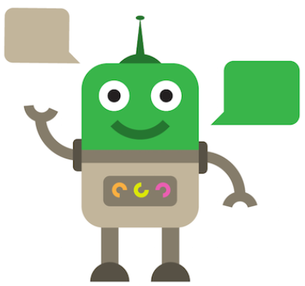
Say Hello to REBOT
Notes:
Scratch
With Scratch, you can program your own interactive stories, games, and animations — and share your creations with others around the world. Scratch was created to help people learn to think creatively, reason systematically and work collaboratively.
Python, HTML/JSON
Hands-on practice to learn how website is built using HTML. And using Python, you can learn how to extract information from website and transform the data from unstructured data (HTML) into structured data (database or spreadsheet).
Chatbot
Apply web scraping technique involving Python, HTML/JSON to build a conversational UI.
Example of conversational UI e.g. live chat customer service

Slide 9

PLAYING WITH Baby PYTHON +
Notes:
Scratch
With Scratch, you can program your own interactive stories, games, and animations — and share your creations with others around the world. Scratch was created to help people learn to think creatively, reason systematically and work collaboratively.
Python, HTML/JSON
Hands-on practice to learn how website is built using HTML. And using Python, you can learn how to extract information from website and transform the data from unstructured data (HTML) into structured data (database or spreadsheet).
Chatbot
Apply web scraping technique involving Python, HTML/JSON to build a conversational UI.
Example of conversational UI e.g. live chat customer service

Slide 10


Team Challenge Taming the Python
Notes:
Scratch
With Scratch, you can program your own interactive stories, games, and animations — and share your creations with others around the world. Scratch was created to help people learn to think creatively, reason systematically and work collaboratively.
Python, HTML/JSON
Hands-on practice to learn how website is built using HTML. And using Python, you can learn how to extract information from website and transform the data from unstructured data (HTML) into structured data (database or spreadsheet).
Chatbot
Apply web scraping technique involving Python, HTML/JSON to build a conversational UI.
Example of conversational UI e.g. live chat customer service

Slide 11

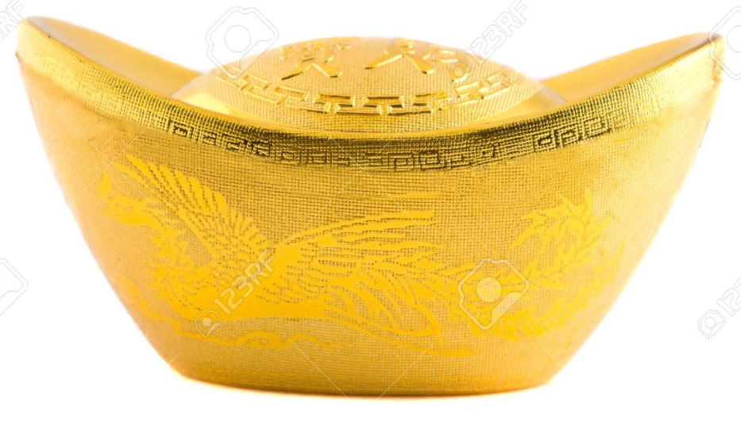
Rules of the Game
Earn as many gold coins as possible by completing the challenges
Challenges are to be completed in sequence.
=
 | Gold Coins
Challenge 1
Challenge 2
Challenge 3
Bonus Challenge
Challenges 5 and onwards

Slide 12
Rules of the Game
If you are stuck,
Refer to training materials – Free
Seek help from another sub-team - 1
Ask the facilitators for help – 2

Slide 13
Prizes to be won
Overall Best Team aka Techie Masters
The team with the most number of gold coins and gold nuggets
Overall Best Sub-Team aka Techie Buddies
The sub-team with the most number of gold coins and gold nuggets
Overall Best Coder aka Tech Guru
Decided by the TD Emcees and Game Master

Slide 14
Are you ready? Let’s go !

Slide 15
SHORT break
Notes:
Scratch
With Scratch, you can program your own interactive stories, games, and animations — and share your creations with others around the world. Scratch was created to help people learn to think creatively, reason systematically and work collaboratively.
Python, HTML/JSON
Hands-on practice to learn how website is built using HTML. And using Python, you can learn how to extract information from website and transform the data from unstructured data (HTML) into structured data (database or spreadsheet).
Chatbot
Apply web scraping technique involving Python, HTML/JSON to build a conversational UI.
Example of conversational UI e.g. live chat customer service

Slide 16
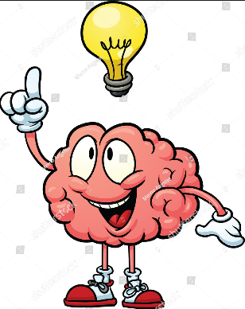
Idea Generation and Pitch How would you want to leverage on skills learnt today to make a difference in your job?
Notes:
Scratch
With Scratch, you can program your own interactive stories, games, and animations — and share your creations with others around the world. Scratch was created to help people learn to think creatively, reason systematically and work collaboratively.
Python, HTML/JSON
Hands-on practice to learn how website is built using HTML. And using Python, you can learn how to extract information from website and transform the data from unstructured data (HTML) into structured data (database or spreadsheet).
Chatbot
Apply web scraping technique involving Python, HTML/JSON to build a conversational UI.
Example of conversational UI e.g. live chat customer service

Slide 17

The Award goes to…
Notes:
Scratch
With Scratch, you can program your own interactive stories, games, and animations — and share your creations with others around the world. Scratch was created to help people learn to think creatively, reason systematically and work collaboratively.
Python, HTML/JSON
Hands-on practice to learn how website is built using HTML. And using Python, you can learn how to extract information from website and transform the data from unstructured data (HTML) into structured data (database or spreadsheet).
Chatbot
Apply web scraping technique involving Python, HTML/JSON to build a conversational UI.
Example of conversational UI e.g. live chat customer service

Slide 18
THANK YOU
Notes:
Scratch
With Scratch, you can program your own interactive stories, games, and animations — and share your creations with others around the world. Scratch was created to help people learn to think creatively, reason systematically and work collaboratively.
Python, HTML/JSON
Hands-on practice to learn how website is built using HTML. And using Python, you can learn how to extract information from website and transform the data from unstructured data (HTML) into structured data (database or spreadsheet).
Chatbot
Apply web scraping technique involving Python, HTML/JSON to build a conversational UI.
Example of conversational UI e.g. live chat customer service

